Slide 1

R2D2s Bazaar Presentation
R2D2s – Nikita, Nisarg, Shrey, and Mayank

Slide 2
Roles
Nik- Servers and Back-End
Shrey- AI
Mayank- Documentation and Front-End
Nisarg- Front-End and Databases

Slide 3
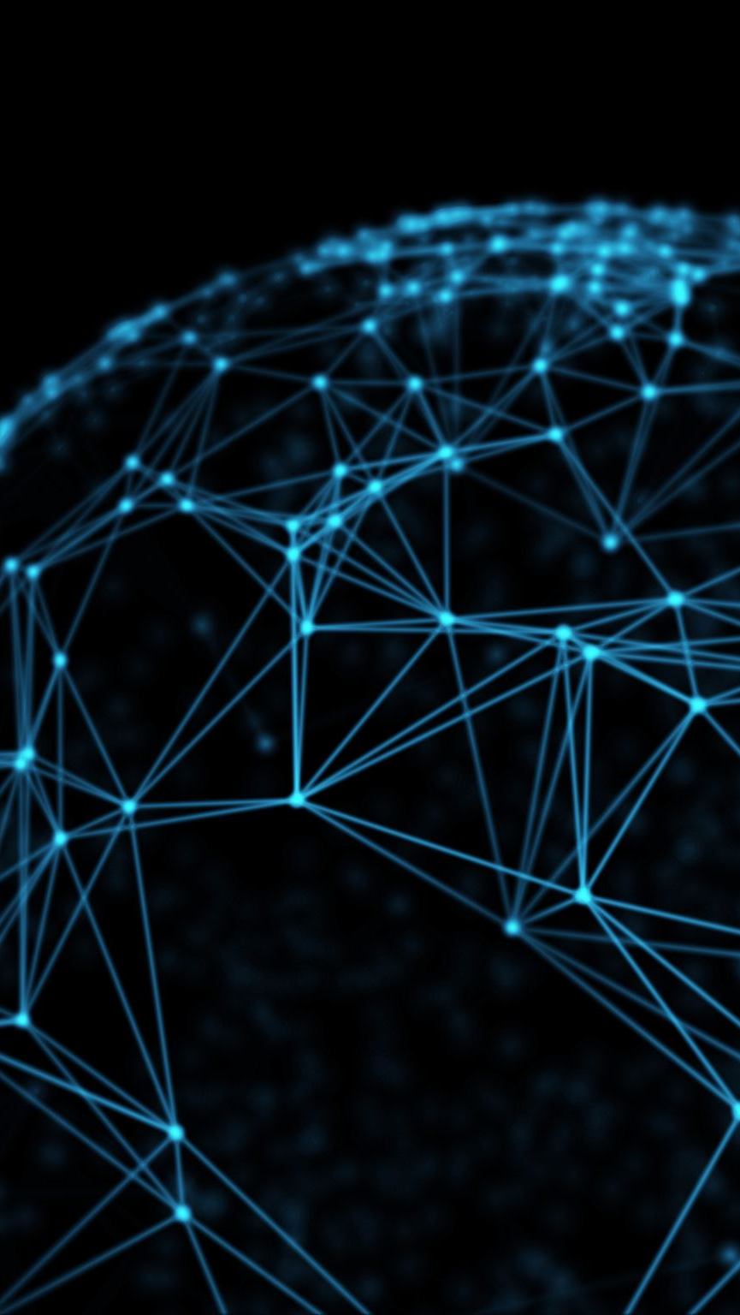
The Idea
A live-streaming service that lets users translate live-streamed content to the users’ preferred language.
Notes:
We are building a service that will let users overcome language barriers by letting them translate live-streamed content to a language of their choice so that they can enjoy content they previously could not.

Slide 4
Implementation
Server
RTMP
Django
React

Slide 5
When we met
13 Sep. 2022
The Idea is born.
20 Sep. 2022
Prototyping and such
23 Sep. 2022
Switching to Python
9 Oct. 2022
How to stream? AWS? Something? Anything?
15 Oct. 2022
The Bazaar looms large.
22 Oct. 2022
The First Working Session
29 Oct. 2022
Changes
7 Nov. 2022
Bazaar
16 Nov. 2022
After Bazaar
29 Nov.
Final Vlog
6 Dec. 2022
Adjourned
9 Jan. 2023
Restarting,
Planning, and Executing
20 Jan. 2023
Cultivator

Slide 6
Changes
Layout Changes (Not Final Yet).
Switching Streaming Media Format.
Changing Microservices on servers.
Notes:
Layout has changed from our prototypes because some implementing some of the designs was not feasible with progressive webapps.
We changed the streaming media format to flv because it has better integrating with the RTMP servers.
We have changed some microservices behind the scenes something that integrates better with our requirements

Slide 7

Demo/Documentation

Slide 8

Work in Progress
Front-End Resources
File Format
Offline AI Models.
UI Components

Slide 9
Future Work
i18n
Django RTMP encoder
micro services (kubernetes)
Linux set up
AI
CI/CD
python threading
video adapter in a browser(build from 0)

Slide 10
Status

Slide 11
Issues
RTMP server file management
Offline models compilation

Slide 12
Constraints/Feedback

Slide 13

Questions

